Slide 1

PROJECT 0
RSA-based Public-key Certification Authority (CA)
RAHUL KUMAR(2020110),MOHD SHAKIR(2020524)

Slide 2
RSA IMPLEMENTATION
RSA has been implemented from scratch in the helper my_rsa.py file.
Functions
generate_keypair(p, q) - This function takes two prime numbers p and q as inputs and returns the public key as (n, e) and the private key as (n, d).
inverse_mod(a, m) - This function takes two integers a and m as inputs and returns the modular multiplicative inverse of a modulo m, for co-prime numbers a and m.
encrypt(pk, plaintext) - This function takes a public key pk and a plaintext string as inputs and returns the corresponding ciphertext as a list of integers.
decrypt(pk, ciphertext) - This function takes a private key pk and a ciphertext as a list of integers as inputs and returns the corresponding plaintext string.

Slide 3
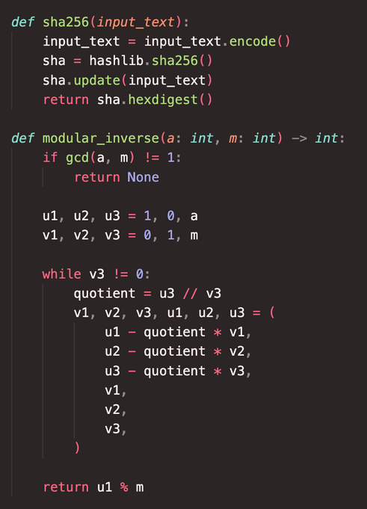
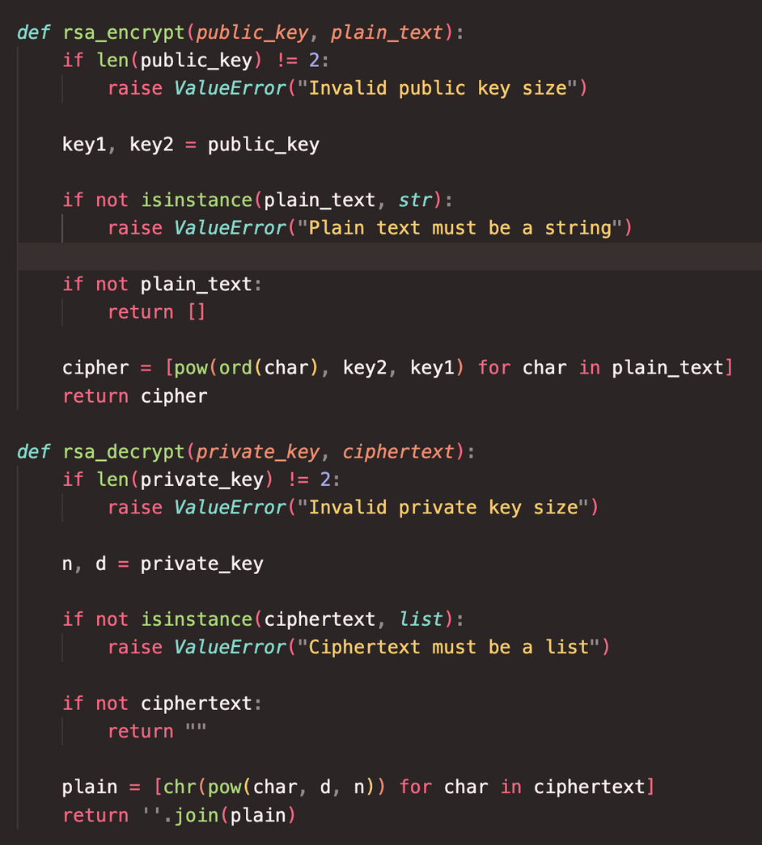
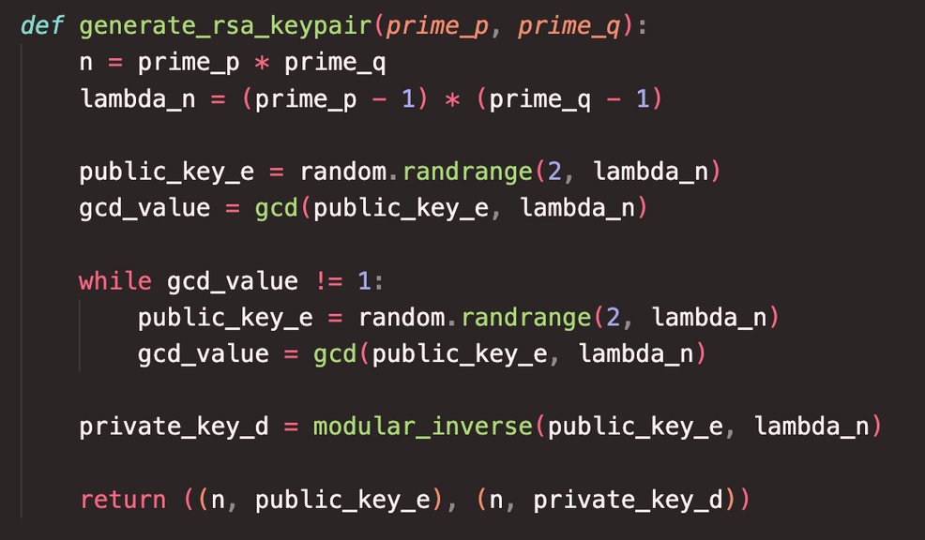

Slide 4
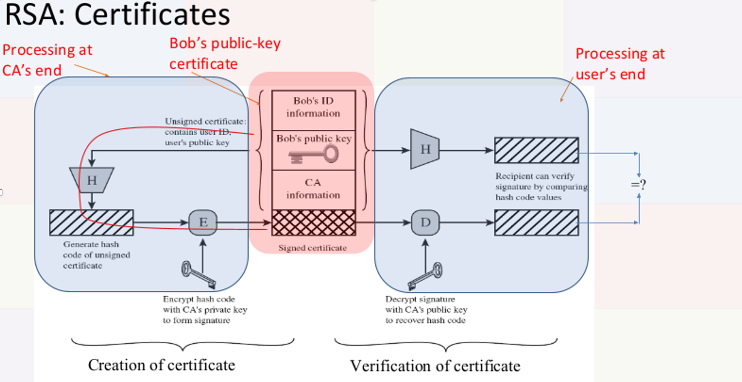

Slide 5
CERTIFICATE STRUCTURE
CERTA == [IDA, PUA, TA, DURA, INFOCA, ENCPR_CA(Hash(IDA, PUA, TA, DURA, INFOCA))]
where
●IDA is user ID
●PUA is public key of A
●TA is time of issuance of certificate
●DURA is the duration for which the certificate is valid
●INFOCA is information about certification authority
●ENC is the encryption algorithm used by CA
●PRCA is public key of certification authority
Hash: Hashing function used is SHA-256

Slide 6
Any registered user can perform the following actions:
1. Request CA for certificate
2. Check available certificates
3. Make/Update my certificate
4. Check my certificate validity
5. Send message
6. Check messages
7. Logout
Ques : Who generates the pair of keys [private-key, public-key] for the clients?
The clients generate the pair of keys [private-key, public-key] during registration. They specify the values of p and q, from which the keys are derived.
Ques : How does the CA and/or client get to know it?
When a client registers, the CA is informed of its public key. The client then requests the issuance of a certificate through the option 'Make/Update my certificate'. This certificate is stored by the CA and can be requested by any client via 'Request CA for certificate'.

Slide 7

Thank You

